Slide 1

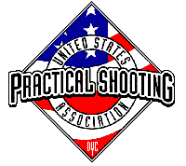
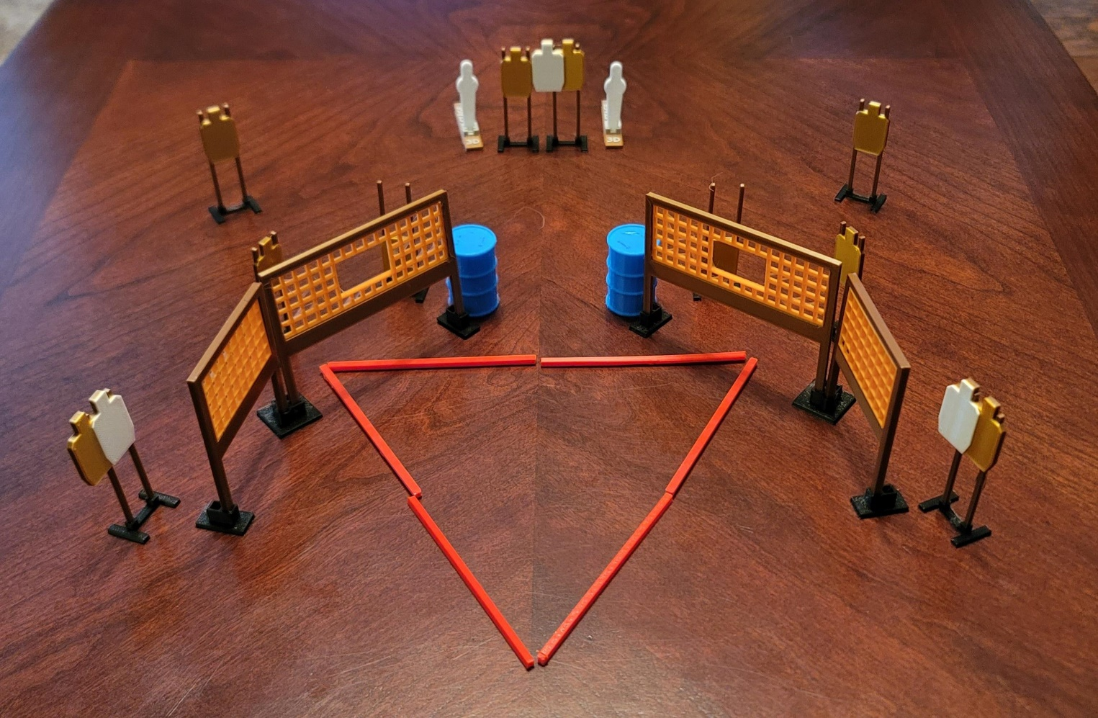
 | Dothan Gun Club – USPSA Match Bermuda Triangle Course Designer : Eric Henwood
Round Count 32 rounds 10 USPSA 2 mini poppers
Equipment List 8 wall feet 13 targets (10 + 3 NS)

Slide 2
Bermuda Triangle
Written Stage Briefing
Bermuda Triangle is a 32 round, 110-point, Comstock course of fire. There are 10 USPSA targets and 2 steel. The best 3 hits on cardboard will score and steel must fall to score.
Handgun start position is anywhere completely outside the shooting area, wrists below belt. Handgun is loaded and holstered.
PCC start position is anywhere completely outside the shooting area, stock on belt. Loaded carbine is held with both hands.
On the audible start signal, engage targets as they become available from within the shooting area.

